Slide 1
Civics Class:9 3: Electoral Politics
PPT: 1

Slide 4
Democracies
Elections take place regularly in any democracy. There are more than 100 countries in the world in which elections take place to choose people’s representatives.

Slide 5
What is election?
The mechanism by which people can choose their representatives at regular intervals and change them whenever they want to is called an election.

Slide 6
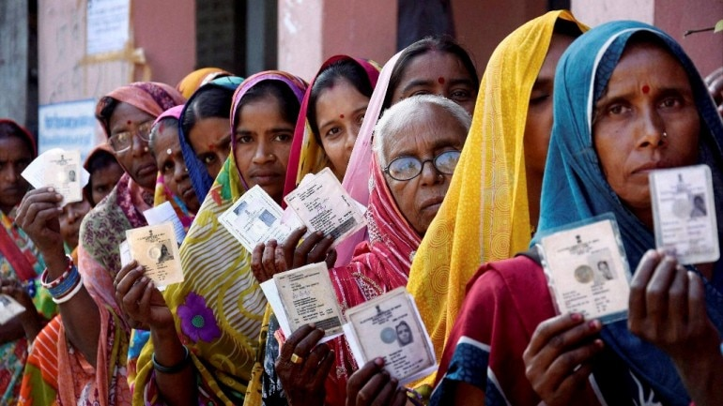
People participate in Voting

Slide 7
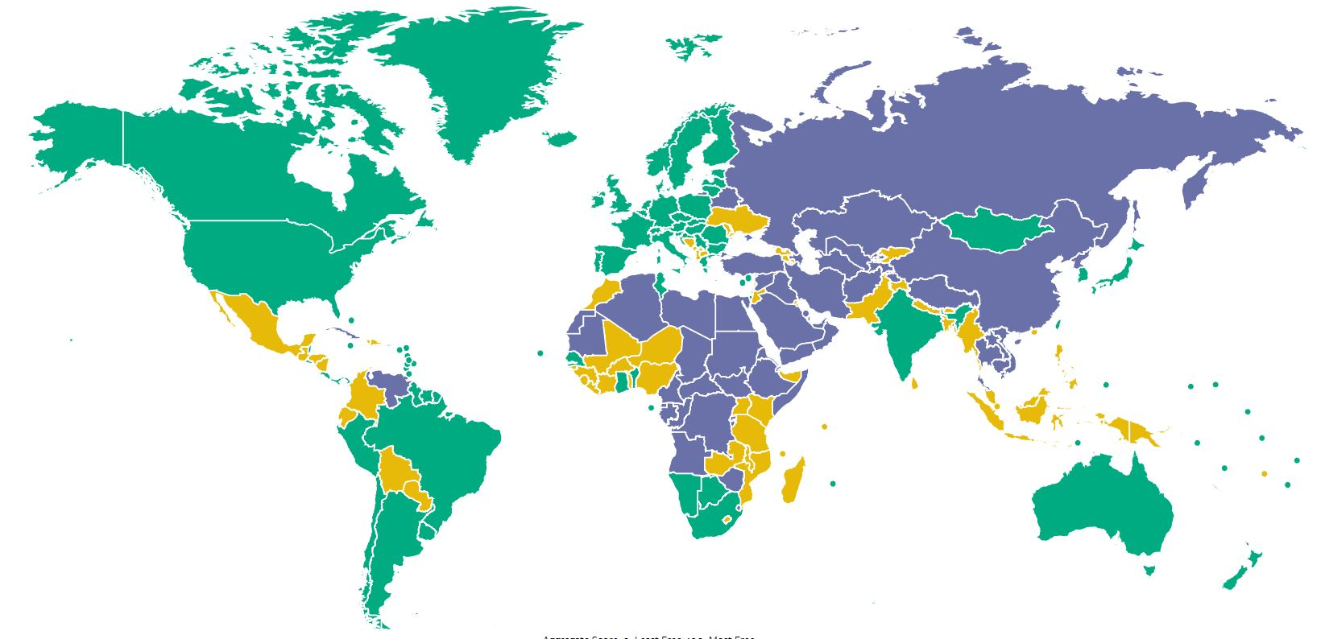
The Green shaded countries are democracies

Slide 8
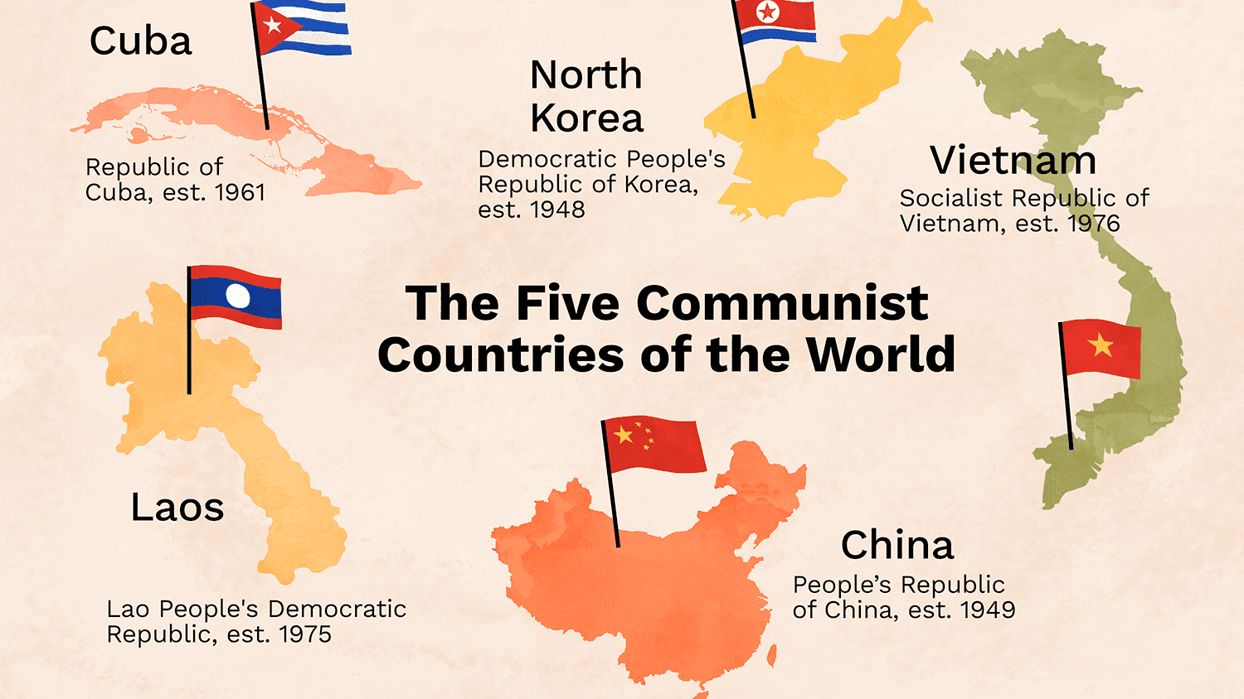
Countries with out democratic freedom

Slide 9
In an election the voters make many choices:
They can choose who will make laws for them.
They can choose who will form the government and take major decisions.
They can choose the party whose policies will guide the government and law making.

Slide 12
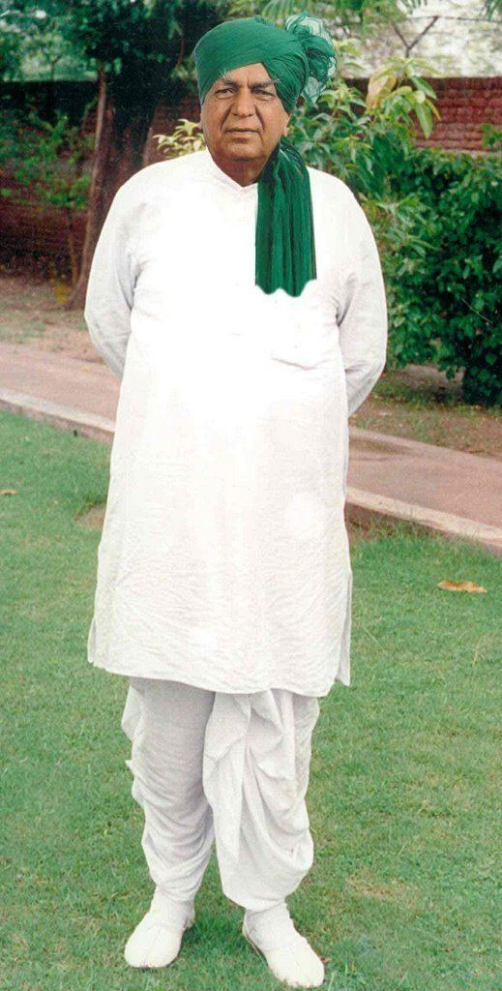
Chaudhary Devi Lal

Slide 17
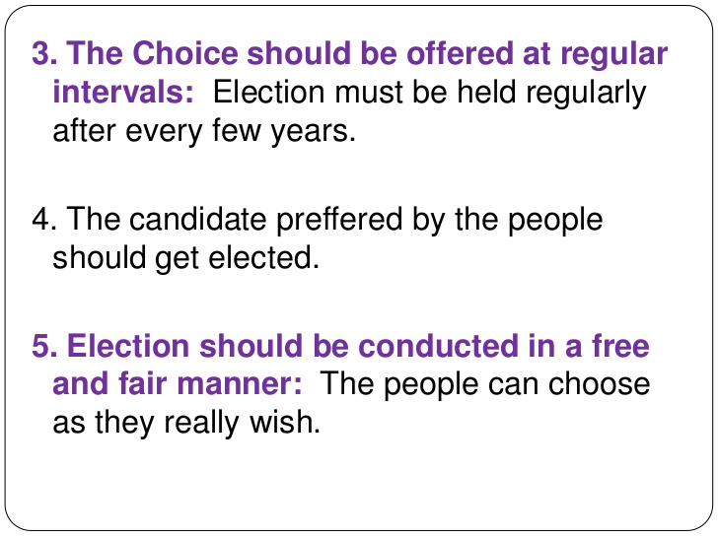

Slide 19
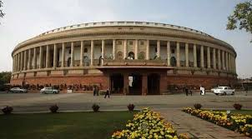
Indian Parliament (Rajya Sabha & LokSabha)

Slide 20
Rajya Sabha The Rajya Sabha is to consist of not more than 250 members - 238 members representing the States and Union Territories, and 12 members nominated by the President. Rajya Sabha is a permanent body and is not subject to dissolution. However, one third of the members retire every second year, and are replaced by newly elected members. Each member is elected for a term of six years.

Slide 21
Lok Sabha The Lok Sabha is composed of representatives of people chosen by direct election on the basis of Universal Adult Suffrage. Maximum strength of the House is 552 members - 530 members to represent the States, 20 members to represent the Union Territories, and 2 members to be nominated by the President from the Anglo-Indian Community. At present, the strength of the House is 545.

Slide 22
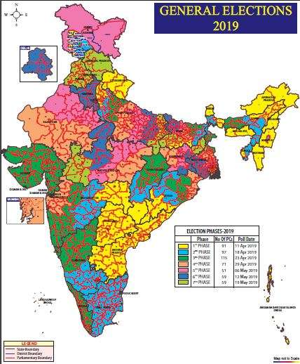
India map with Lok Sabha constituencies

